Slide 1
Optics optimization and chromaticity correction in PS2 NMC rings
PS2 meeting
Y. Papaphilippou
March 19th, 2007

Slide 2
Outline
Optimised NMC ring with dispersion supressor
Refining the straight section matching
Chromaticity correction
First order
Second order and chromatic beta beating
2

Slide 3
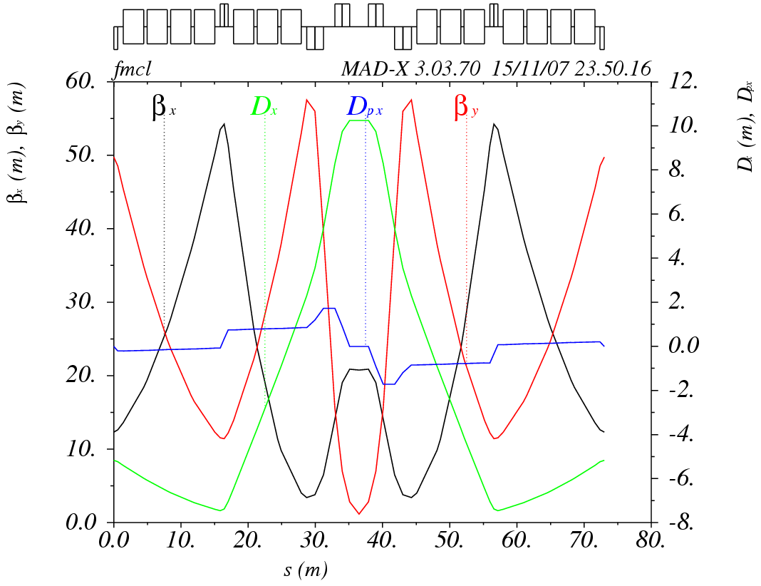
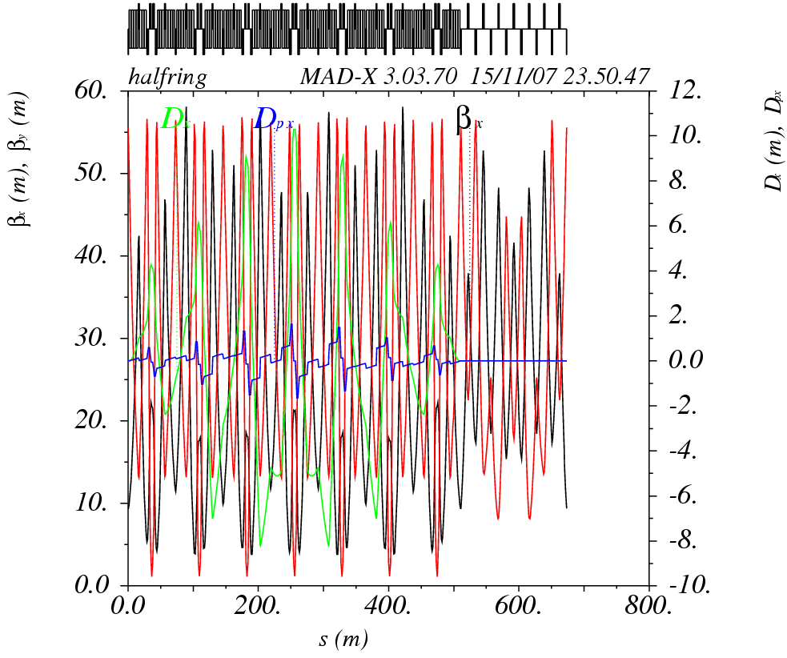
The NMC ring II
Arc module with 1 asymmetric FODO cell with 4 + 3 bends and a low-beta doublet with 4 families of quads, with max. strength of 0.1m⁻² and total length of 73m
Suppressing arc dispersion with phase advance close to multiple of 2π and 2 extra quad families
Straight section with 7 FODO cells drift of 9.5m) using 2 matching quadrupoles
Ring of 1346m, with 10 quad families (max strength of 0.1m⁻²)
Tunes of (13.8,13.4), γ_{t} of 10.9i, chromaticities of -18.7, -29.5
Max beta of 58m and 56m and min. and max. dispersion of -8.2m and 10.2m
Matching not perfect for horizontal phase advance of 90º in the straights

Slide 4
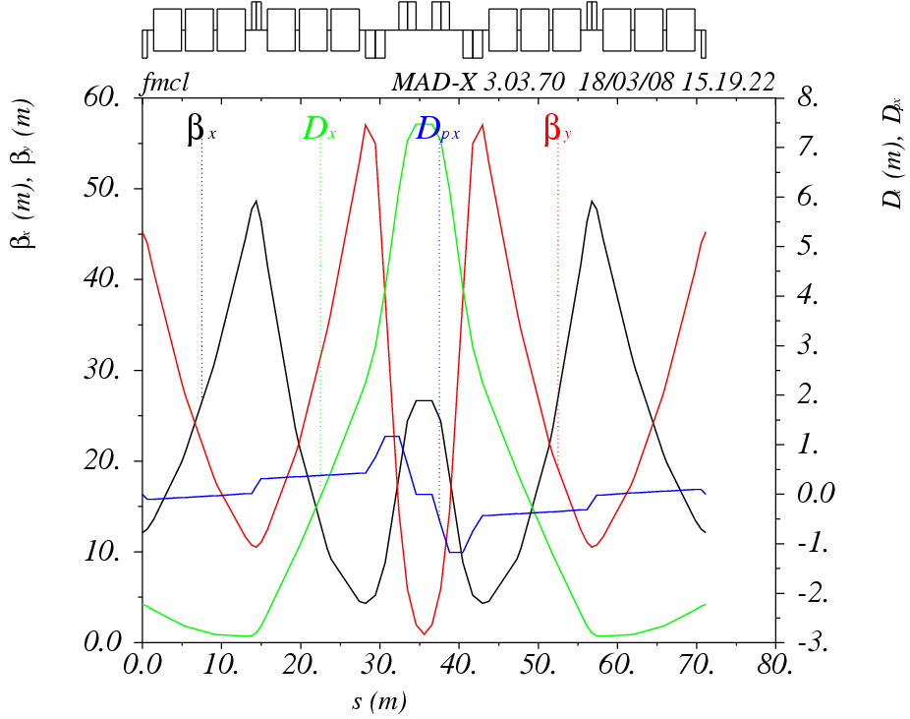
Optimizing the arc module
1 symmetric FODO cell with 3 + 3 bends and a low-beta doublet
Phase advances of 294º,310º per module
γ_{t} of 10.2i
4 families of quads, with max. strength of 0.1m⁻²
Max. beta of 49m and 57m
Min. dispersion of -2.9m and maximum of 7.5m

Slide 5
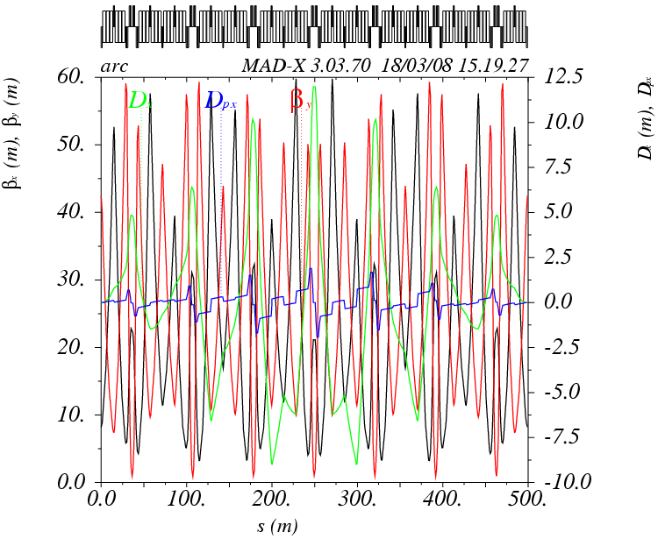
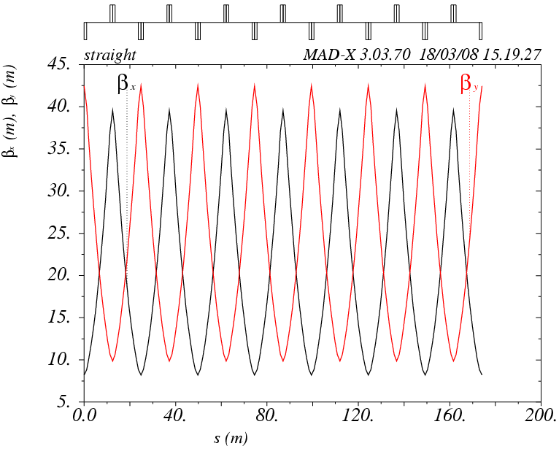
Arc and straight section
Dispersion suppression with 2 extra quad families in the last arc modules
Last arc quad. shared between arc and straight
Straight section with horizontal phase advance of 87.5º
Straight section drift of 10.2m
Only two families of quadrupoles are used
Extra two families can be added for extra internal phase adjustments
Perfectly matched to the arc

Slide 6
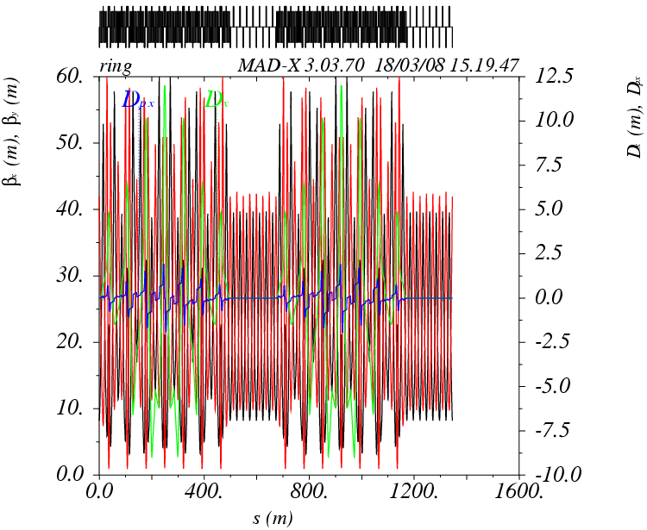
The NMC ring II
Three types of 8 (+2) quadrupole families (max. strength of 0.1m⁻²) for a length of 1346.4m
γ_{t} of 11i
Tunes matched to (14.8,15.2)
Max. β’s of around 60m both planes
Dispersion of -2.3m and maximum of 4.6m
Tunability between 14 and 16 in both planes but penalty on the beta function maxima
Chromaticities of -21.5, -32.2

Slide 7
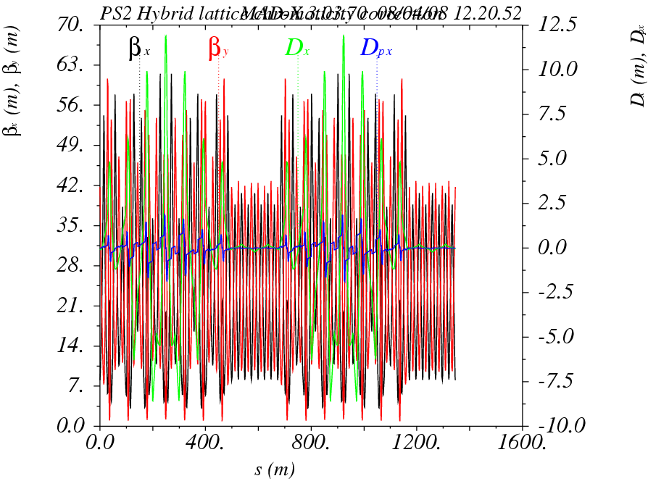
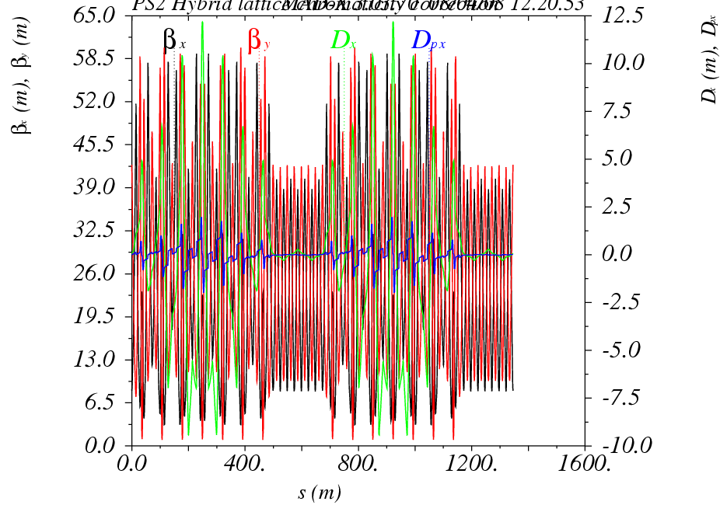
Chromaticity correction
Sextupoles of 0.4m long placed in the low beta doublet
In principle 2 families needed for chromaticity correction
Second-order chromaticity and off-momentum β-beating not corrected
δp/p=-0.5%
δp/p=0.5%

Slide 8
Next steps
Optimise and correct chromaticity in NMC ring I (module with dispersion suppressor)
Optimise sextupole strength and working point for good dynamic aperture
Introduce non-linear correction schemes
8

