Slide 1
Optics considerations for PS2
Dejan Trbojevic, Yannis Papaphilippou, and Ricardo de Maria
February 20, 2008

Slide 2
Outline
Introduction: Flexible Momentum Compaction
An example of PS2 racetrack lattice with γ_{t}= i 13, with the basic block γ_{t}=i 10.4 and zero dis. straight
  Fundamental block γ_{t}=i 10.4
  Matching Block
  Zero dispersion straight sections
  1346 meters race-track
Next necessary steps

Slide 3
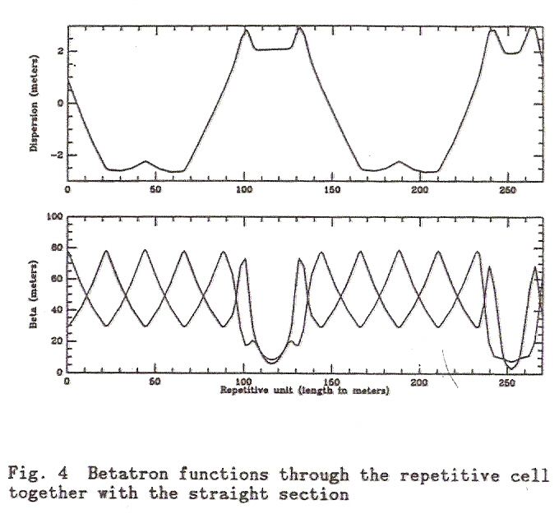
Flexible Momentum Compaction Modules
The first publication: D. Trbojevic et. all, “Design Method of High Energy Accelerator Without Transition Crossing”,EPAC 90, Nice, 1536-1538.
I had introduced new
“normalized dispersion” space
with coordinates:
Placing the ξ vector bellow the vertical axis χ makes the momentum compaction α_{c} < 0 the total integral negative:

Slide 4
Design and optics constraints for PS2 ring are followed
Basic beam parameters | This example required
Injection kinetic energy [GeV] | 4
Extraction kinetic energy [GeV] | ~ 50
Circumference [m] | 1346 1346
Transition energy [GeV] | 13i 10i
Maximum bending field [T] | 1.73 < 1.8
Maximum quadrupole gradient [T/m] | 17.56 < 17
Maximum beta functions [m] | 34.3 < 60
Maximum dispersion function [m] | –2.45 – 2 < 6
Minimum drift space for dipoles [m] | 0.5 0.5
Minimum drift space for quads [m] | 0.45 – 1.6 0.8

Slide 5
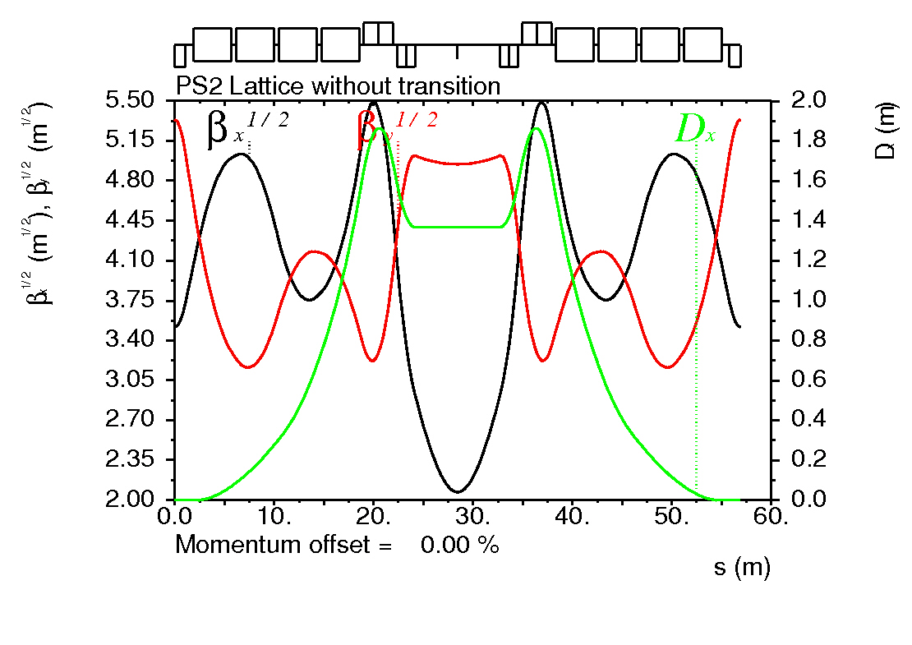
High filling factor FMC
The “high-filling” factor arc module
γ_{t} of 10 i
Max. horizontal beta of 32 m and vertical of 34 m
Min. dispersion of –2.45m and maximum of 2 m
Chromaticities of -1.96-1.14
Total length of 59.3 m

Slide 6
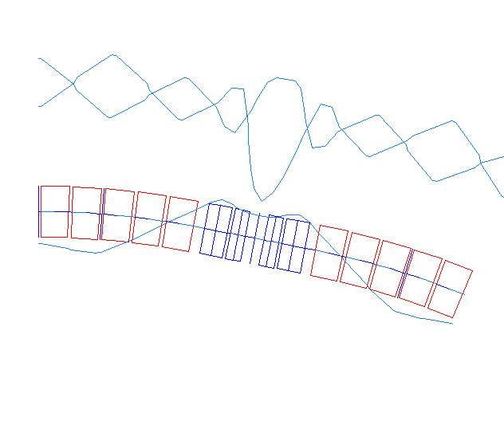
The fundamental block – the arc module
The combined function dipoles are used to provide better filling factor.
The gradient in the in the focusing bend is G_{F}=+3.993 T/m, while in the defocusing bend is G_{D}=−4.18 T/m
B_{f}
B_{f}
G_{F3}
G_{F3}
B_{f}
B_{f}
B_{d}
B_{d}
B_{d}
G_{D3}
G_{D3}
B_{d}
The gradient in the in the focusing quad is G_{F}=+17.55 T/m, while in the defocusing quad is G_{D}=−14.37 T/m
B_{d}
B_{d}

Slide 7
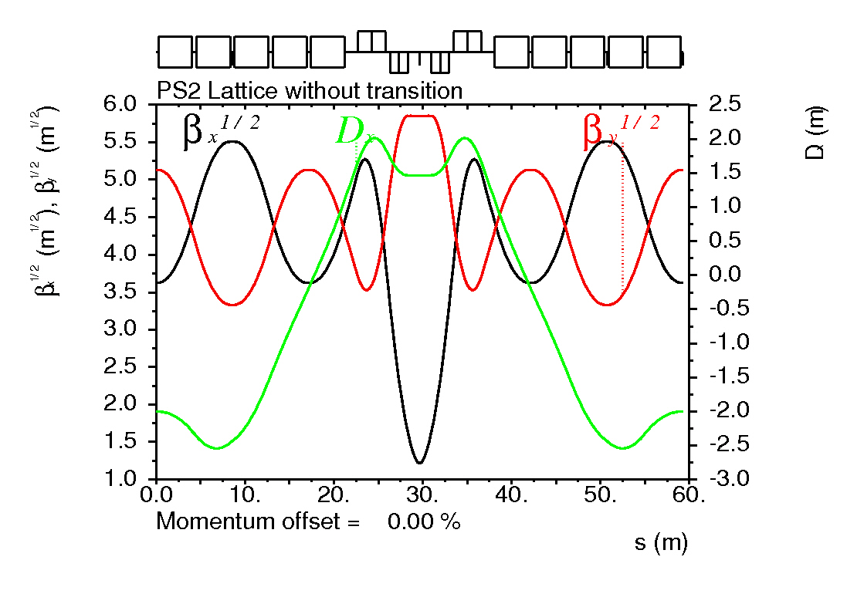
The fundamental block – the arc module
G_{F3}
G_{F3}
B_{d}
B_{f}
B_{f}
B_{d}
B_{d}
G_{D3}
G_{D3}
B_{d}
B_{d}
B_{f}
B_{f}
B_{d}
γ_{t} = i 10.47
ν_{x} = 0.802 − 4.4 ε_{x} +1.9 ε_{y}
ν_{y} = 0.526 + 1.9 ε_{x} +8.1 ε_{y}
The sextupole induced tune shift

Slide 8
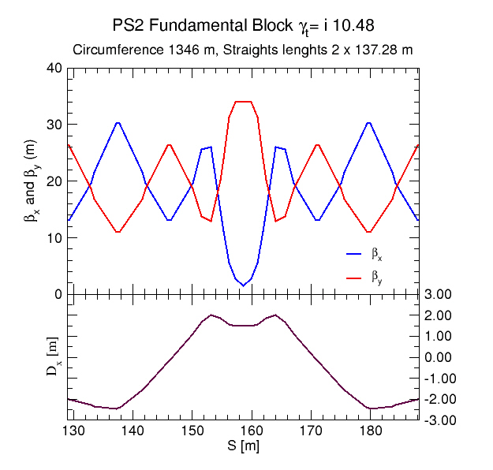
The arc block

Slide 9
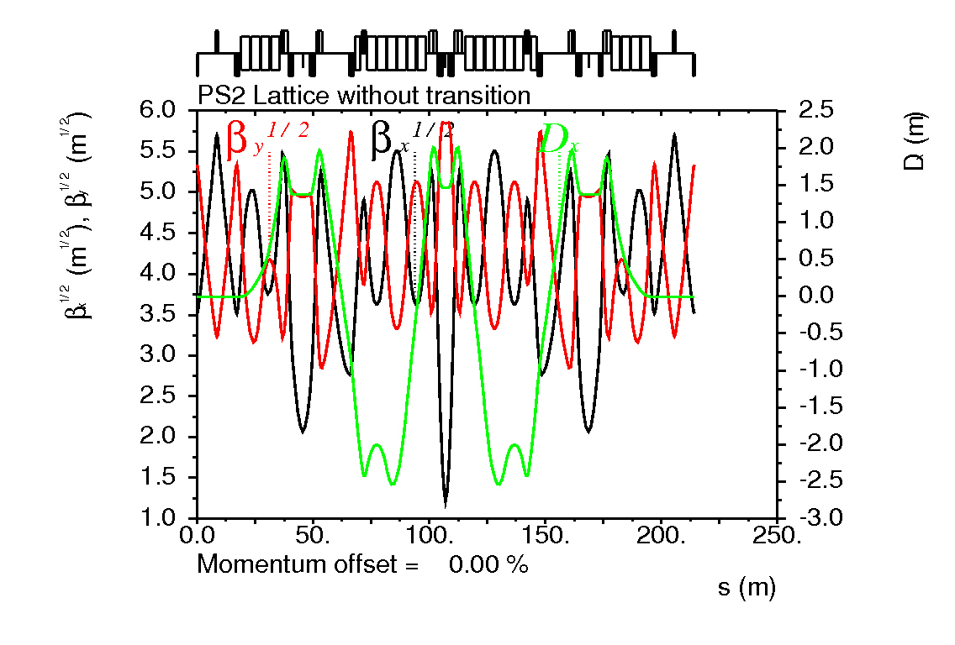
Matching block between a single arc cell in the middle and zero dispersion straight section cells at both ends:
The picture shows zero dispersion in the straight section FODO cell

Slide 10
The matching X-cell to the zero-dispersion straight

Slide 11
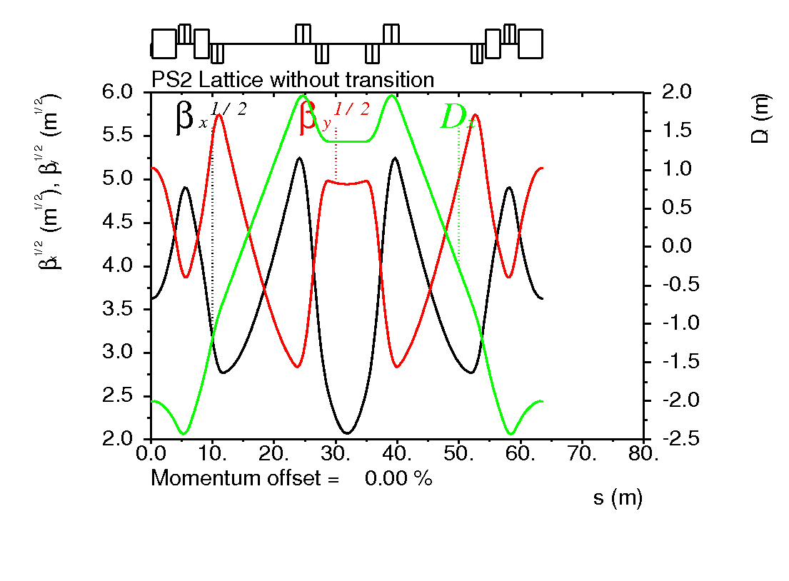
Matching M-cell from X to the basic module in the arcs

Slide 12
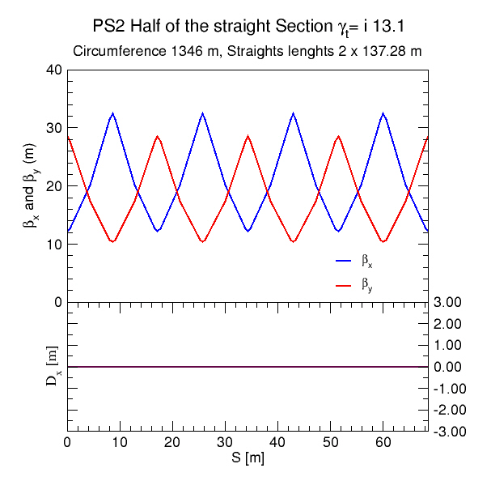
Half of the zero dispersion straight section

Slide 13
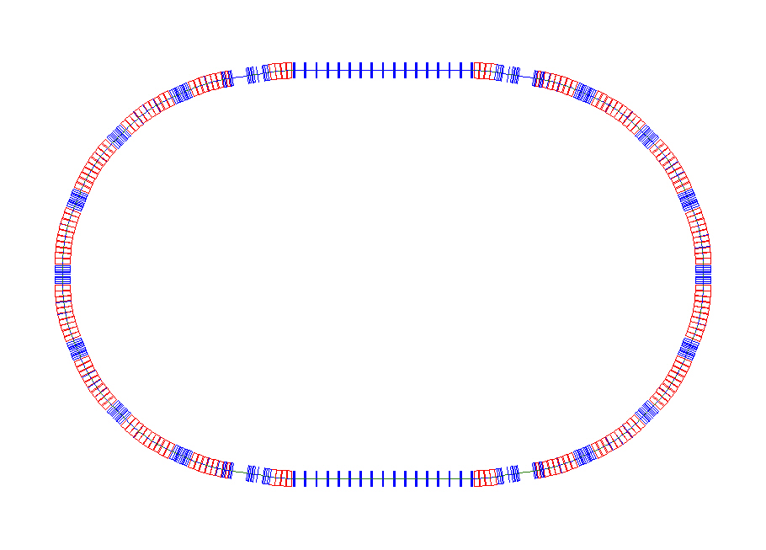
Racetrack PS2 without transition crossing: γ_{t}= i 13.1
Chromaticities:
ξ_{x} =-24.1,ξ_{y} =-16.5,
Circumference:
C=1346 m
Maximae of
betatron functions:
β_{x_max}=32 m,
β_{y_max} =34.3 m,
Dispersion:
-2.45 m < D_{x} < 2.1 m
The amplitude tune
shift by the sextupoles second order tune shift:
ν_{x} = 16.598 + 70. ε_{x} + 59.1 ε_{y}
ν_{y} = 12.405 + 59.1 ε_{x} + 80 ε_{y}

Slide 14
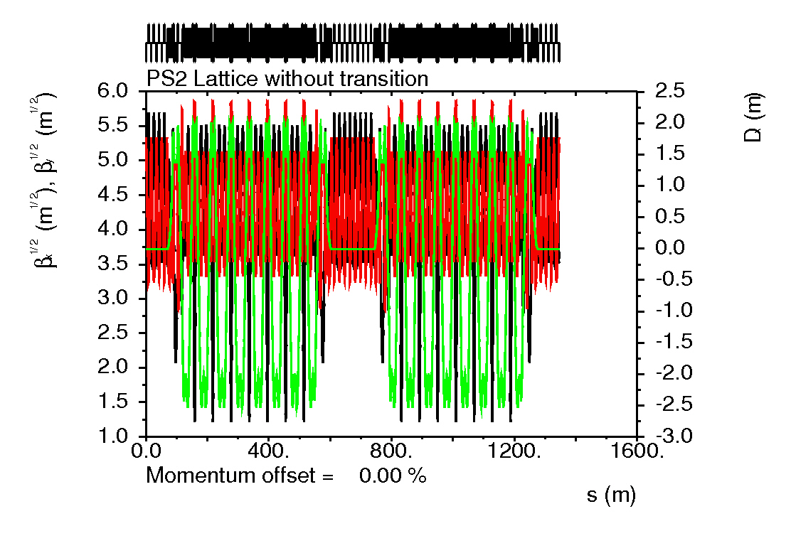
Betatron Functions in the whole ring

Slide 15
Layout
PS2
PSB
Racetrack:
Integration into existing/planned complex:
  Beam injected from SPL
  Short transfer to SPS
  Ions from existing complex
All transfer channels in one straight
Minimum number of D suppressors
  High bending filling factor
  Required to reach 50GeV
PS
SPL
Linac4

Slide 16
Summary
This example looks very decent.
Chromaticity correction: second order tune shift induced by sextupoles is very small.
Very good momentum acceptance.
Tunability pretty good.
Dynamical aperture evaluation needs to be finished.
The value of the γ_{t} needs small correction. This might raise the maximum dispersion values from D_{max}=-2.46 - 2 m to D_{max} -2. 7 – 2.3 m.

