Slide 1
Optics solutions for the PS2 ring
LIS Section Meeting
Y. Papaphilippou
February 11th, 2008

Slide 2
Contributors
W. Bartmann, M. Benedikt, C. Carli, J. Jowett (CERN)
G. Arduini, R. Garobi, B. Goddard, S. Hancock (CERN), Y. Senichev (FZ Jülich), D. Trbojevic (BNL)
Acknowledgements

Slide 3
Outline
Motivation and design constraints for PS2
FODO lattice
Doublet/Triplet
Flexible (Negative) Momentum Compaction modules
  High-filling factor design
  Tunability and optics’ parameter space scan
  “Resonant” NMC ring
  Hybrid solution
Comparison and perspectives
07/02/08
Optics solutions for the PS2 ring
3

Slide 4
Motivation – LHC injectors’ upgrade
Upgrade injector complex.
  Higher injection energy in the SPS => better SPS performance
  Higher reliability
R. Garoby, BEAM’ 07
Present accelerators
Future accelerators
50 MeV
Linac2
Linac4
160 MeV
(LP)SPL: (Low Power) Superconducting Proton Linac (4-5 GeV)
PS2: High Energy PS
(~ 5 to 50 GeV – 0.3 Hz)
SPS+: Superconducting SPS (50 to1000 GeV)
SLHC: “Super-luminosity” LHC (up to 10³⁵ cm⁻²s⁻¹)
DLHC: “Double energy” LHC (1 to ~14 TeV)
1.4 GeV
PSB
(LP)SPL
4 GeV
26 GeV
PS
PS2
50 GeV
Output energy
450 GeV
SPS
SPS+
1 TeV
LHC /
SLHC
DLHC
7 TeV
~ 14 TeV

Slide 5
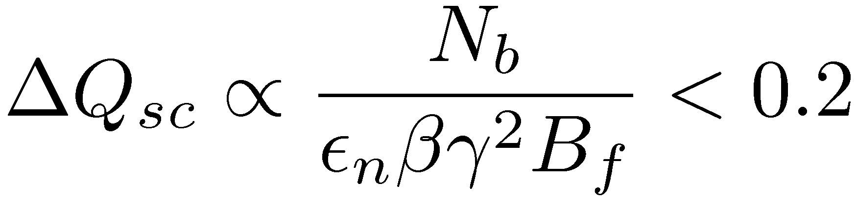
Design and optics constraints for PS2 ring
Replace the ageing PS and improve options for physics
  Provide 4x10¹¹ protons/bunch for LHC (vs. 1.7x10¹¹)
  Higher intensity for fixed target experiments
Integration in existing CERN accelerator complex
Versatile machine:
  Many different beams and bunch patterns
  Protons and ions
Constrained by incoherent
space charge tune-shift
Basic beam parameters | PS | PS2
Injection kinetic energy [GeV] | 1.4 | 4
Extraction kinetic energy [GeV] | 13/25 | 50
Circumference [m] | 200π | 1346
Transition energy [GeV] | 6 | ~10/10i
Maximum bending field [T] | 1.2 | 1.8
Maximum quadrupole gradient [T/m] | 5 | 17
Maximum beta functions [m] | 23 | 60
Maximum dispersion function [m] | 3 | 6
Minimum drift space for dipoles [m] | 1 | 0.5
Minimum drift space for quads [m] |  | 0.8
Maximum arc length [m] |  | 510
Improve SPS performance
Analysis of possible bunch patterns: C_{PS2} = (15/77) C_{SPS} = (15/7) C_{PS}
Longitudinal aspects
Normal conducting magnets
Aperture considerations for high intensity SPS physics beam
Space considerations

Slide 6
Layout
PS2
PSB
Racetrack:
Integration into existing/planned complex:
  Beam injected from SPL
  Short transfer to SPS
  Ions from existing complex
All transfer channels in one straight
Minimum number of D suppressors
  High bending filling factor
  Required to reach 50GeV
PS
SPL
Linac4

Slide 7
FODO Ring
Conventional Approach:
  FODO with missing dipole for dispersion suppression in straights
  7 LSS cells, 22 asymmetric FODO arc cells, 2 dipoles per half cell, 2 quadrupole families
  Phase advance of 88º, γ_{tr} of 11.4
  7 cells/straight and 22 cells/arc
  -> in total 58 cells
  Q_{H,V} = 14.1-14.9
  Alternative design with matching section and increased number of quadrupole families
  Transition jump scheme under study

Slide 8
Dispersion suppressor and straight section
Cell length [m] | 23.21
Dipole length [m] | 3.79
Quadrupole length [m] | 1.49
LSS [m] | 324.99
Free drift [m] | 10.12
# arc cells | 22
# LSS cells: | 7
# dipoles: | 168
# quadrupoles: | 116
# dipoles/half cell: | 2
Extraction
Fast Injection
H⁻-Injection
MTEBK
MS2
MS1
ES
MTEBK
BD
DuK
ExtK
InjK
InjS
H⁰S
H⁻InjS
7 cells

Slide 9
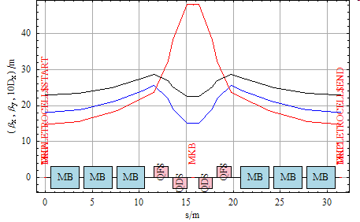
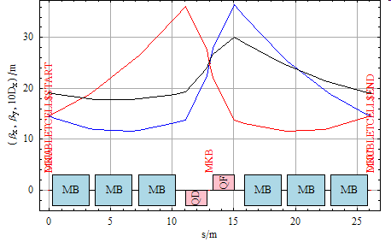
Doublet and Triplet arc cells
Advantages
  Long straight sections and small maximum ß’s in bending magnets (especially for triplet)
Disadvantage
  High focusing gradients

Slide 10
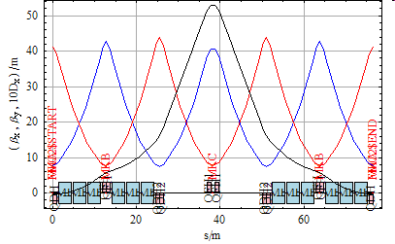
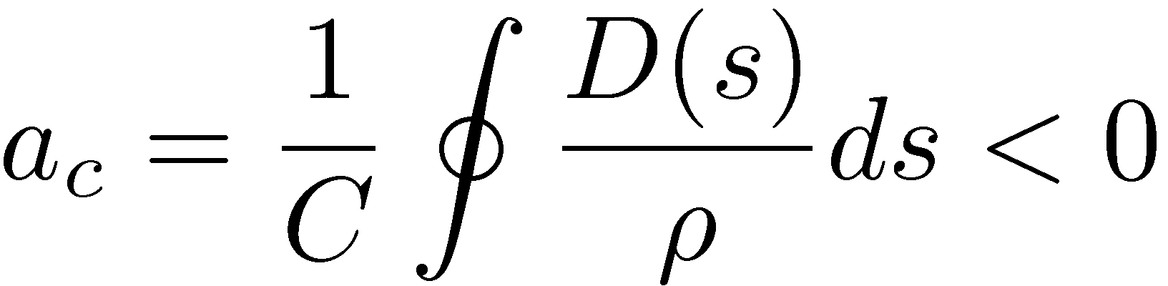
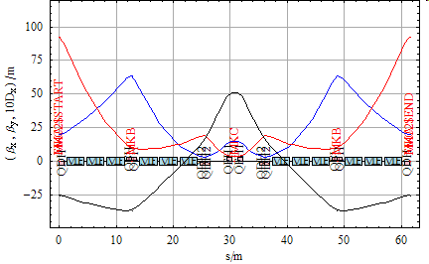
Flexible Momentum Compaction Modules
Aim at negative momentum compaction (NMC modules), i.e.
Similar to and inspired from existing modules
(SY. Lee et al, PRE, 1992, J-PARC high energy ring)
First approach
  Module made of three FODO cells
  Match regular FODO to 90º phase advance
  Reduced central straight section without bends
  Re-matched to obtain phase advance (close to three times that of the FODO, i.e. 270º)
Disadvantage: Maximum vertical β above 80m
regular FODO 90º/cell
-> zero dispersion at beginning/end
reduced drift in center, average 90º/cell
-> negative dispersion at beginning/end
γ_{tr} ~ 10i

Slide 11
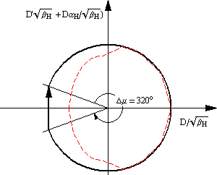
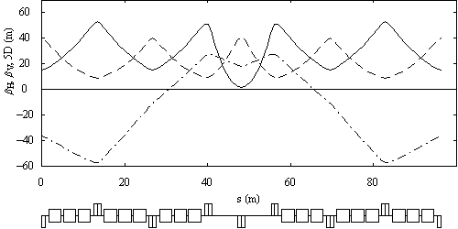
NMC modules with high filling factor
Improve filling factor: four FODO per module
Dispersion beating excited by “kicks” in bends
Resonant behavior: total phase advance < 2π
Large radii of the dispersion vector produce negative momentum compaction
High phase advance is necessary
C. Carli et al. PAC07
In red:
real lattice
Phase advance
with shorter drifts
β_{x}
β_{y}
5D

Slide 12
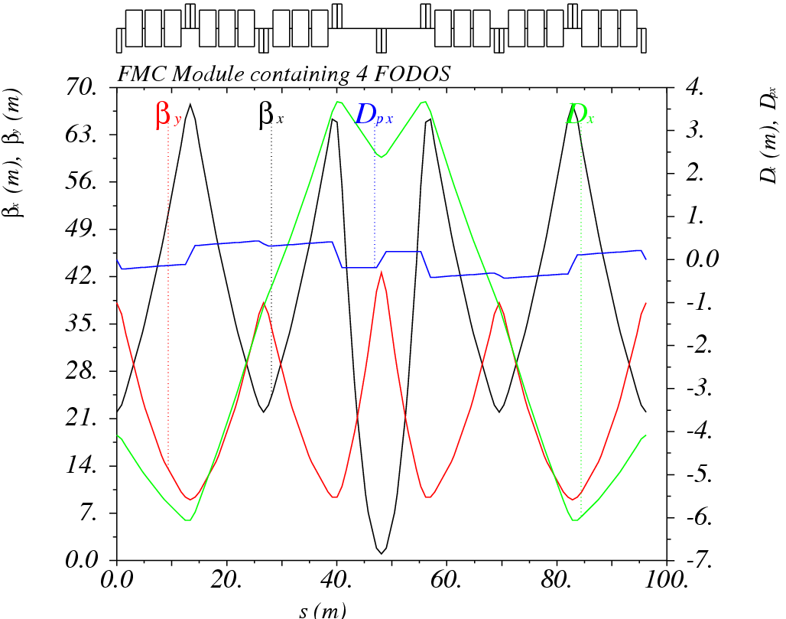
Improving the high filling factor FMC
The “high-filling” factor arc module
  Phase advances of 280º,320º per module
  γ_{t} of 8.2i
  Four families of quads, with max. strength of 0.095m⁻²
  Max. horizontal beta of 67m and vertical of 43m
  Min. dispersion of -6m and maximum of 4m
  Chromaticities of -1.96,-1.14
  Total length of 96.2m
Slightly high horizontal β and particularly long module, leaving very little space for dispersion suppressors and/or long straight sections
Reduce further the transition energy by moving bends towards areas of negative dispersion and shorten the module

Slide 13
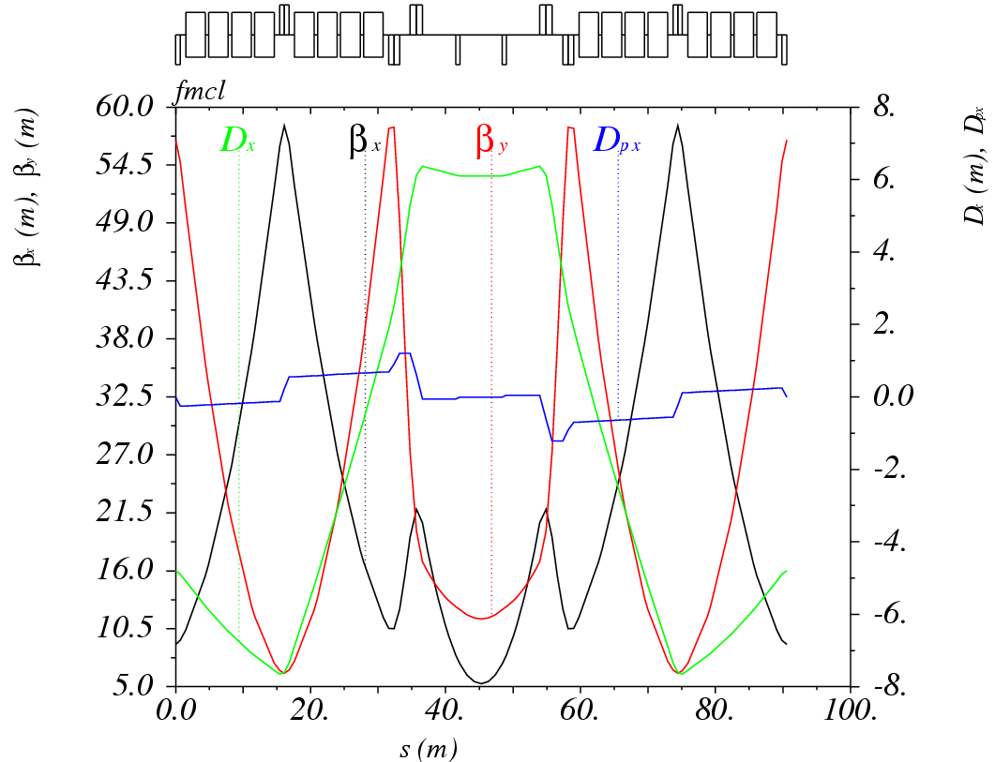
Alternative NMC module
1 FODO cell with 4 + 4 bends and an asymmetric low-beta triplet
  Phase advances of 320º,320º per module
  γ_{t} of 6.2i
  Five families of quads, with max. strength of 0.1m⁻²
  Max. beta of 58m in both planes
  Min. dispersion of -8m and maximum of 6m
  Chromaticities of -1.6,-1.3
  Total length of 90.56m
Fifth quad family not entirely necessary
Straight section in the middle can control γ_{t}
Phase advance tunable between 240º and 330º
Main disadvantage the length of the module, giving an arc of around 560m (5 modules + dispersion suppressors), versus 510m for the FODO cell arc

Slide 14
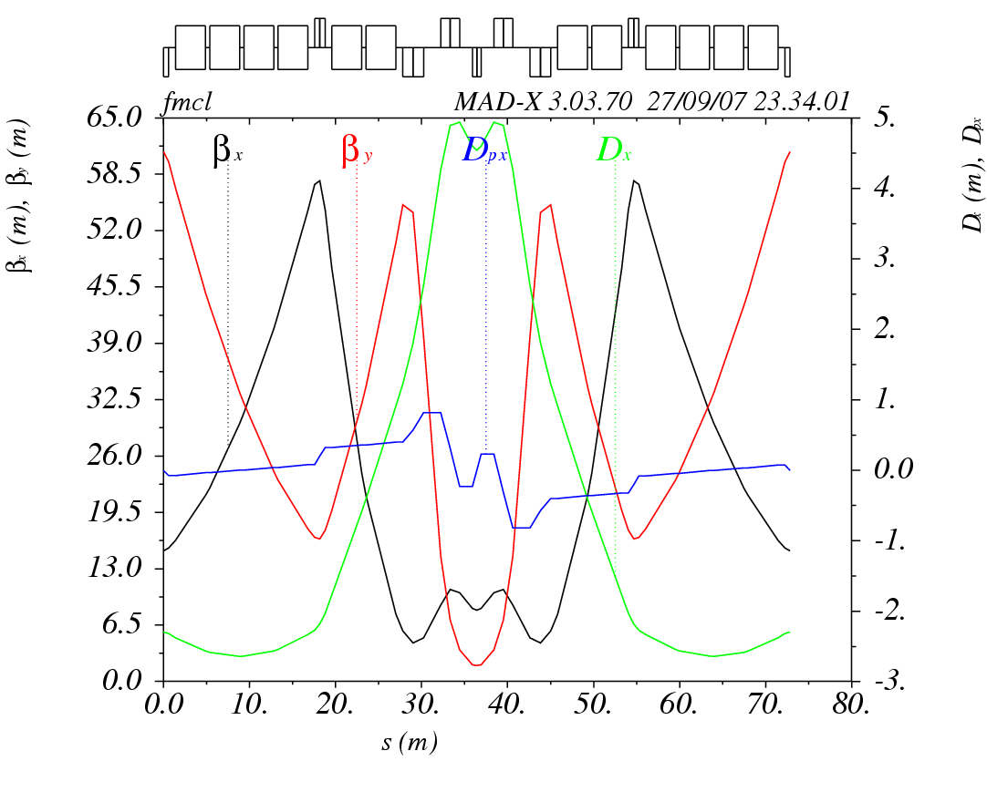
The “short” NMC module
Remove middle straight section and reduce the number of dipoles
1 asymmetric FODO cell with 4 + 2 bends and a low-beta doublet
  Phase advances of 272º,260º per module
  γ_{t} of 10i
  Five families of quads, with max. strength of 0.1m⁻²
  Max. beta of around 60m in both planes
  Min. dispersion of -2.3m and maximum of 4.6m
  Chromaticities of -1.1,-1.7
  Total length of 71.72m
Considering an arc of 6 modules + 2 dispersion suppressors of similar length, the total length of the arc is around 510m

Slide 15
“Tunability”
Phase advance tunable between 240º and 420º in the horizontal and between 250º and 320º in the vertical plane

Slide 16
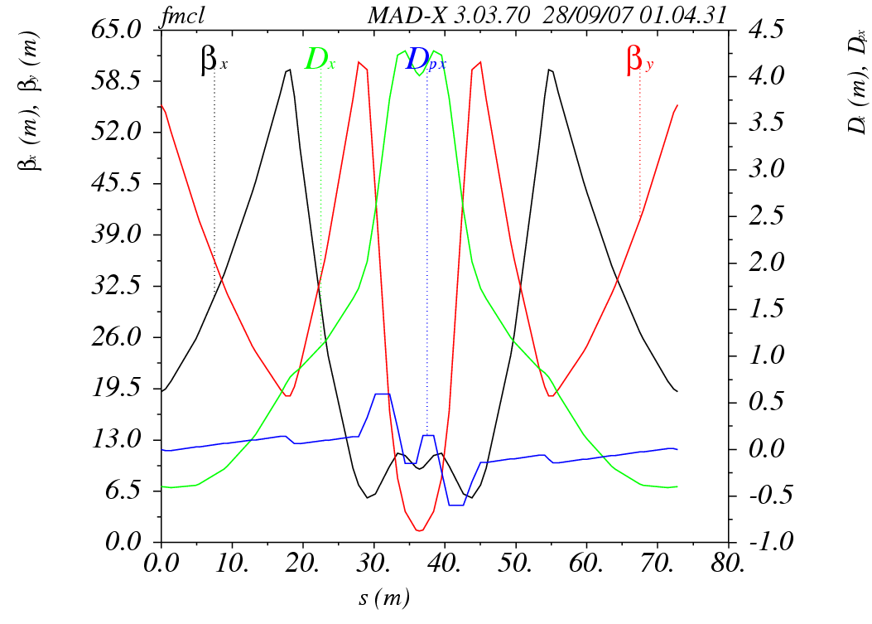
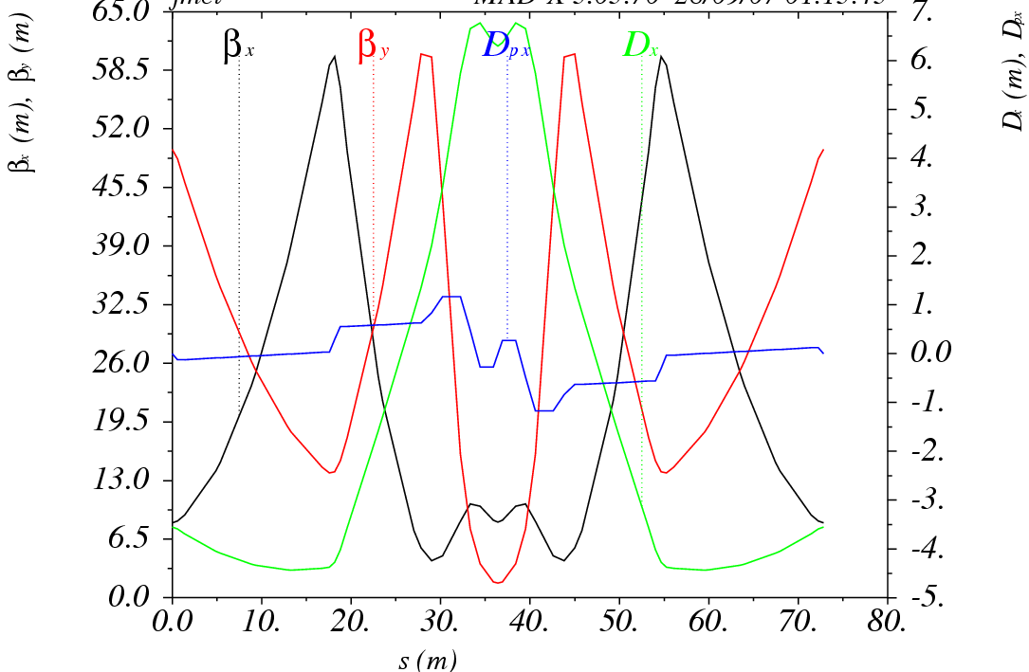
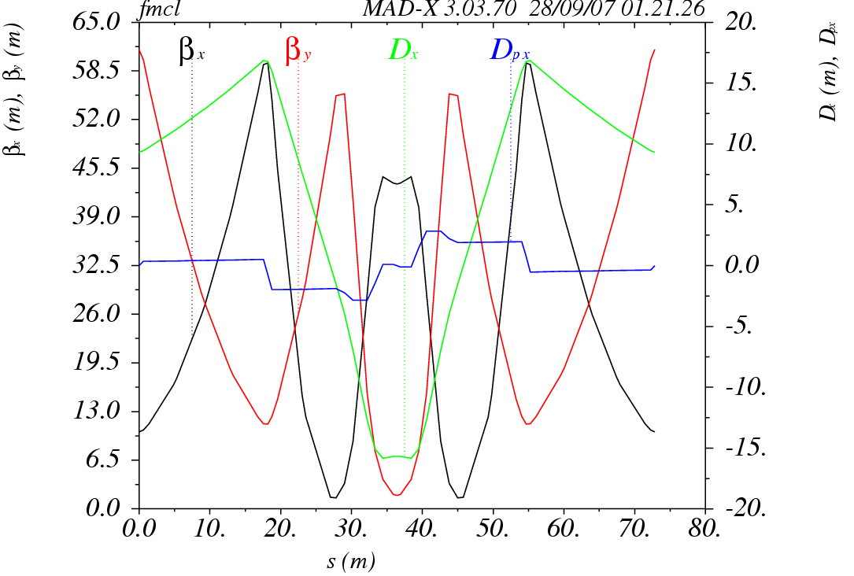
Transition energy versus horizontal phase advance
imaginary

Slide 17
Dispersion versus transition energy
imaginary
Almost linear dependence of momentum compaction with dispersion min/max values
Higher dispersion variation for γ_{t} closer to 0
Smaller dispersion variation for higher γ_{t}

Slide 18
Transition energy versus chromaticity
imaginary
Higher in absolute horizontal chromaticities for smaller transition energies
Vertical chromaticities between -1.8 and -2 (depending on vertical phase advance)
Main challenge: design of dispersion suppressor and matching to straights

Slide 19
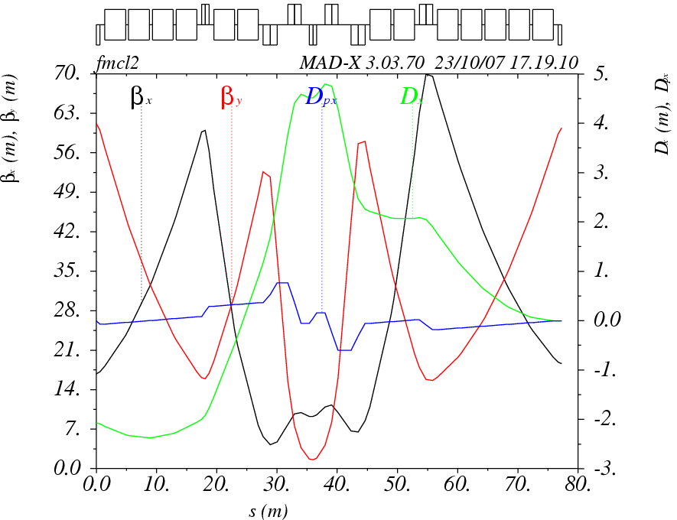
Dispersion suppressor cell
Similar half module as for the NMC with 2+5 dipoles (instead of 2+4)
Using 4 families of quads to suppress dispersion, while keeping beta functions “small”
Maximum beta of 70m
Total length of 77.31m

Slide 20
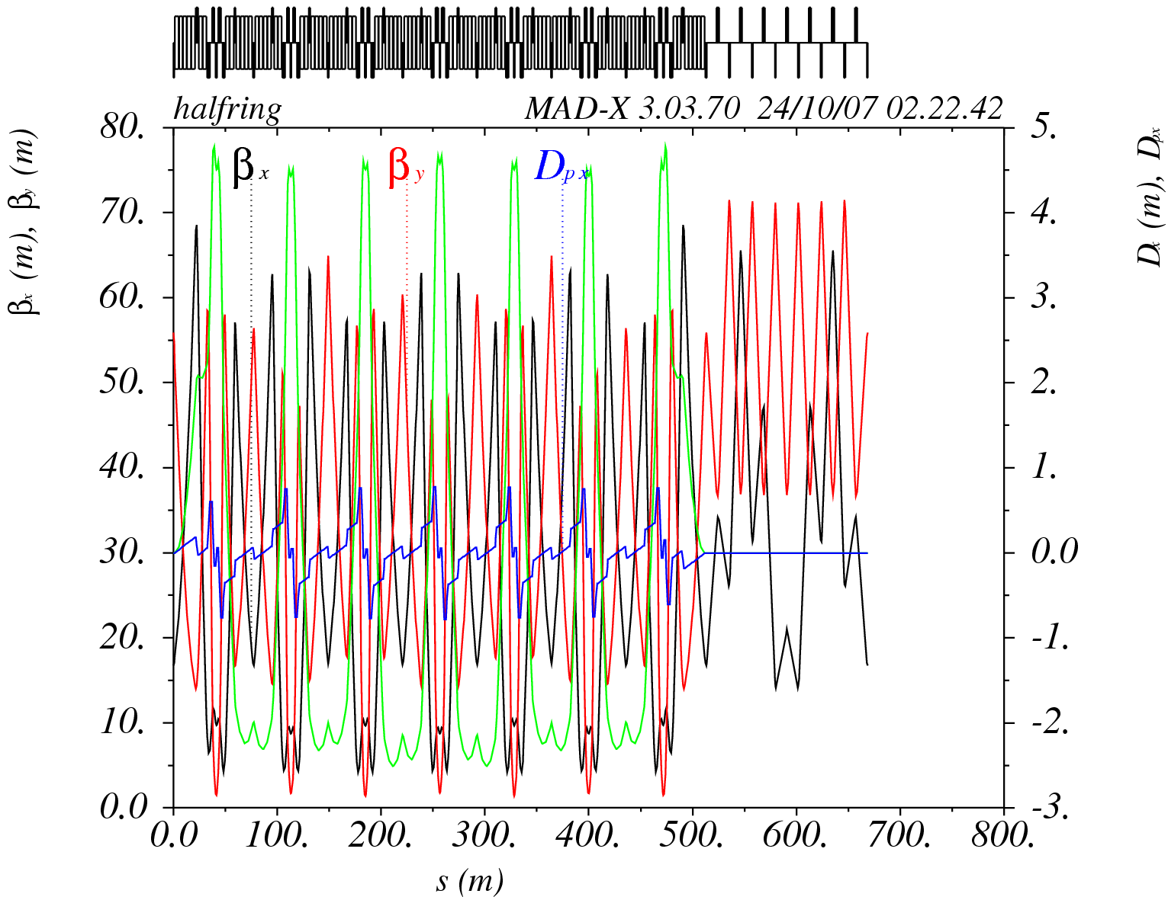
The ring I
Adding a straight section with 7 FODO cells, using 2 matching quadrupoles
  Straight drift of 9.5m
  Tunes of (12.1,11.4)
  γ_{t} of 12.9i
  13 families of quads, with max. strength of 0.1m⁻²
  Max. beta of around 71m in horizontal and 68m in the vertical plane
  Dispersion of -2.3m and maximum of 4.6m
  Chromaticities of -16.7, -25.8
  Total length of 1346m

Slide 21
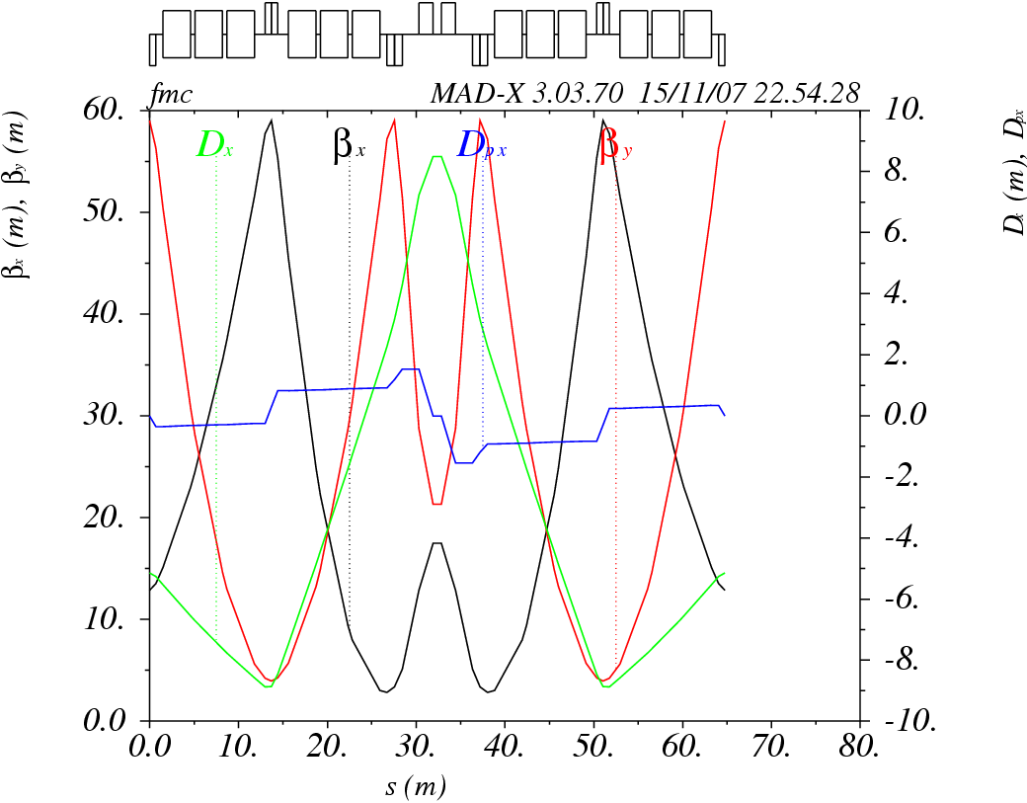
The resonant NMC module
e.g. Y. Senichev BEAM’07
1 symmetric FODO cell with 3 + 3 bends and a low-beta doublet
  Phase advances of 315º,270º per module
    8 x 315º->7 x 2π
    8 x 270º->6 x 2π
  γ_{t} of 5.7i!!!
  Four families of quads, with max. strength of 0.1m⁻²
  Max. beta of around 59m in both planes
  Min. and max. dispersion of -8.5m and 8.9m
  Chromaticities of -1.5,-1.7
  Length of 1.2m between QF and D
  Total length of 64.8m

Slide 22
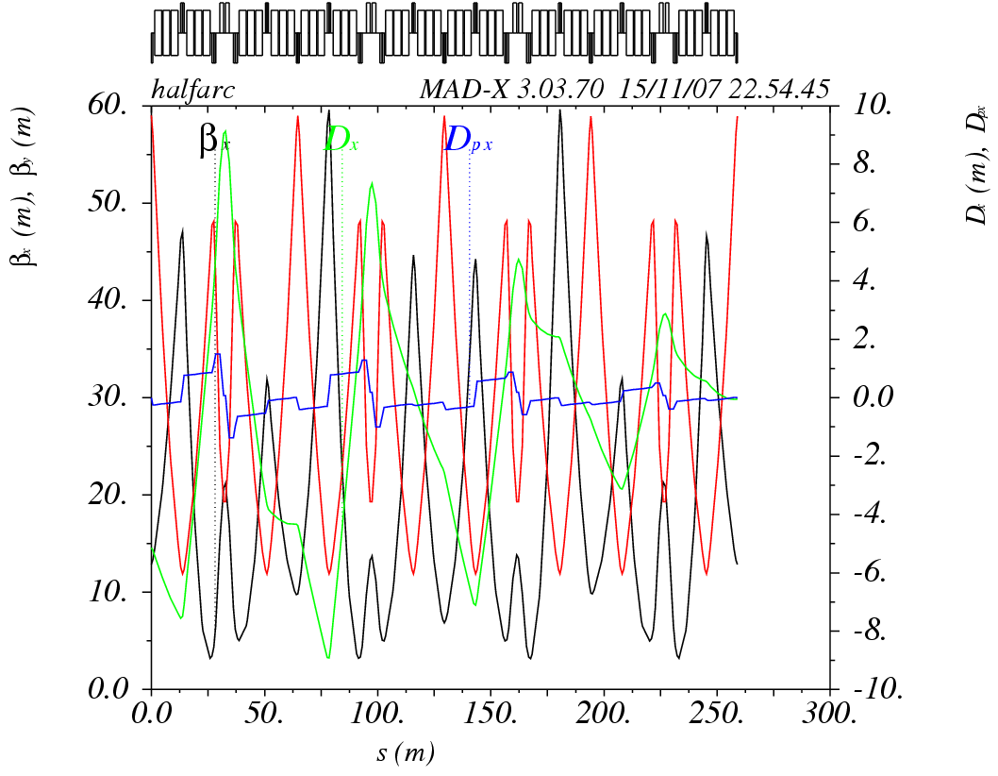
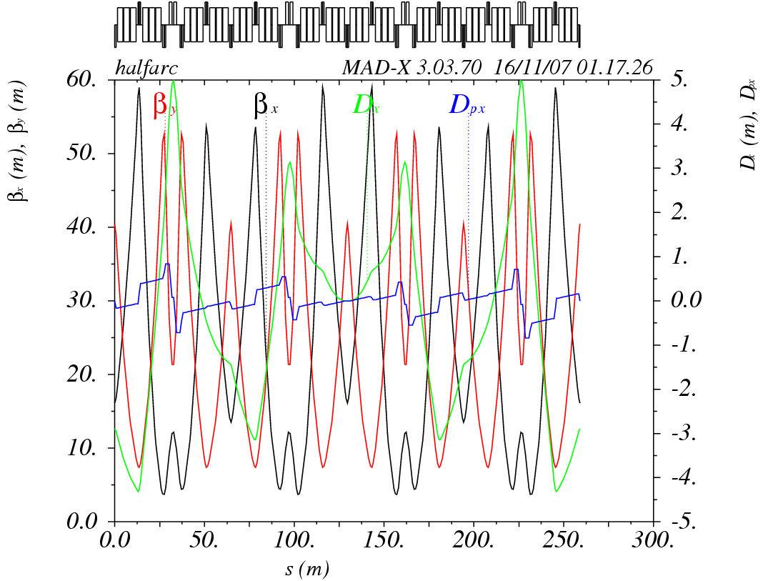
Suppressing dispersion
Dispersion is suppressed by fixing horizontal phase advance to multiple of 2π
Solution with odd number of 2π multiples is preferable for getting lower imaginary γt

Slide 23
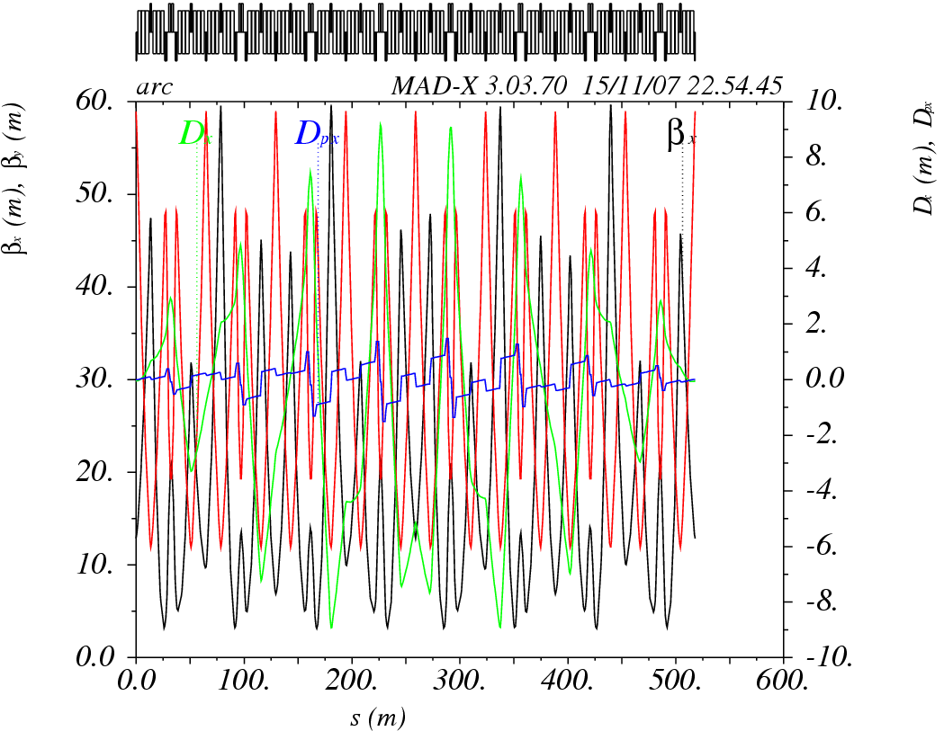
The “resonant” NMC arc
8 NMC modules
Total horizontal phase advance multiple of 2π
Maximum β of 59m
Total length of 518m

Slide 24
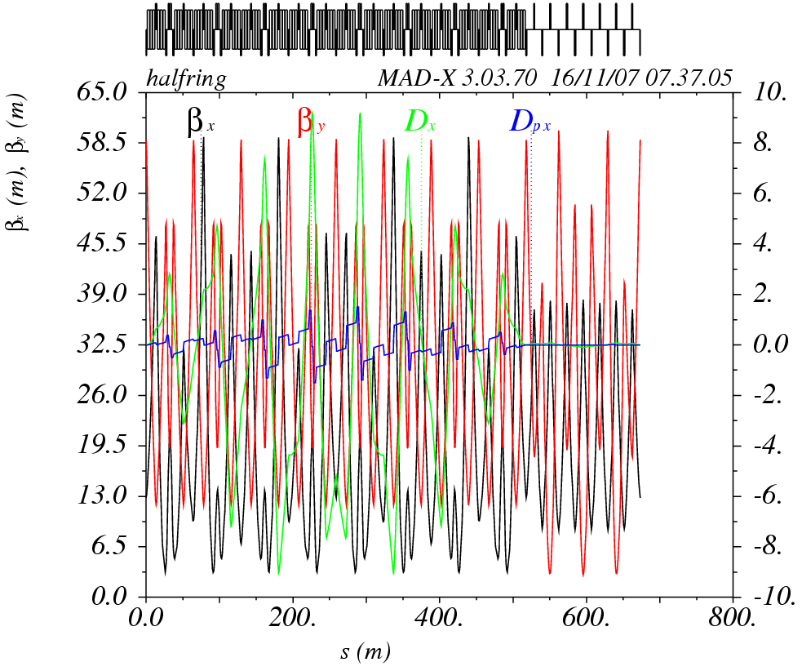
The “resonant” NMC ring II
Adding a straight section with 7 FODO cells, using 2 matching quadrupoles
  Straight drift of 9.4m
  Tunes of (16.8,9.8)
  γ_{t} of 10.7i
  8 families of quads, with max. strength of 0.1m⁻²
    Extra families for phase advance flexibility in the straight
  Max beta of around 60.5m in horizontal and vertical plane
  Min. and max. dispersion of -8.5m and 8.9m
  Chromaticities of -21.7, -19.8
  Total length of 1346m

Slide 25
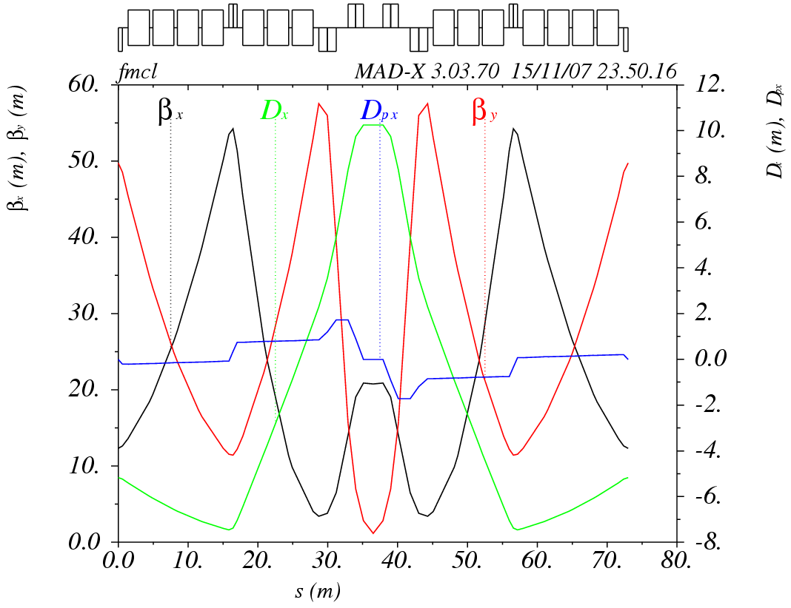
An optimized NMC module
1 asymmetric FODO cell with 4 + 3 bends and a low-beta doublet
  Phase advances of 316º,300º per module
  γ_{t} of 5.6i!!!
  Four families of quads, with max. strength of 0.1m⁻²
  Max. beta of around 54m and 58m
  Min. and max. dispersion of -7.8m and 10.2m
  Chromaticities of -1.3,-2
  Total length of 73m

Slide 26
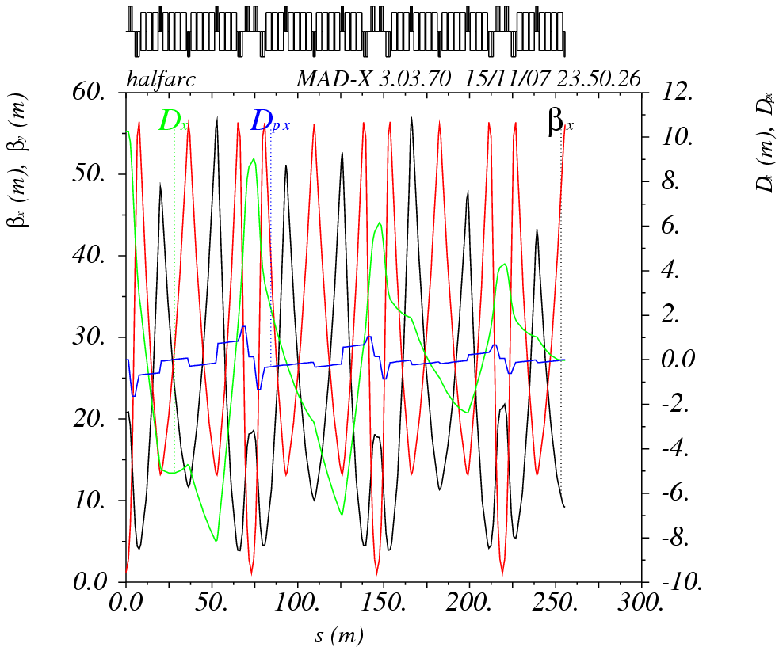
Suppressing dispersion
Hybrid approach:
  Phase advance close to multiple of 2π and 2 extra quad families

Slide 27
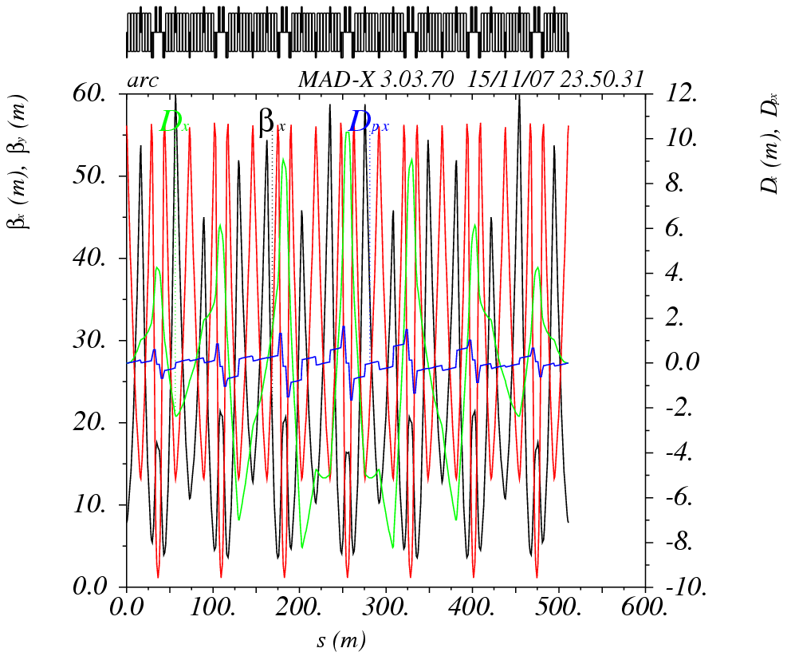
The arc III
7 NMC modules
Phase advances of 5.8 x 2π and 5.5 x 2π
Maximum β of 60m
Total length of 511m

Slide 28
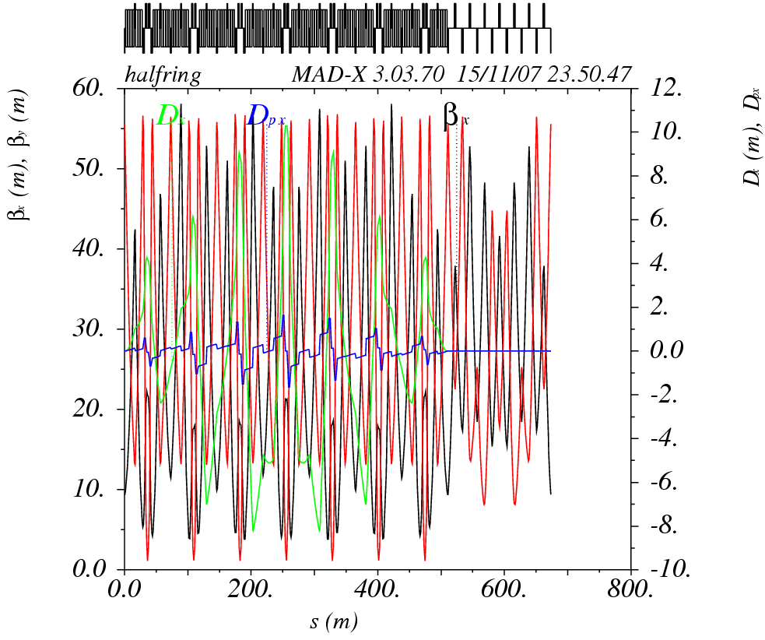
The NMC ring III
Adding a straight section with 7 FODO cells, using 2 matching quadrupoles
  Straight drift of 9.5m
  Tunes of (13.8,13.4)
  γ_{t} of 10.9i
  10 families of quads, with max. strength of 0.1m⁻²
    Extra families for phase advance flexibility in the straight
  Max beta of around 58m in horizontal and 56m in the vertical plane
  Min. and max. dispersion of -8.2m and 10.2m
  Chromaticities of -18.7, -29.5
  Total length of 1346m

Slide 29
Comparison
Parameters | RING I | RING II | RING II
Transition energy | 12.9i | 10.7i | 10.9i
Number of dipoles | 172 | 192 | 196
Dipole length [m] | 3.45 | 3.11 | 3.03
Arc module length [m] | 71.7 | 64.8 | 73
Number of arc modules | 5+2 | 8 | 7
Arc length [m] | 513.5 | 518 | 511
Straight section drift length [m] | 9.5 | 9.4 | 9.5
Quadrupole families | 13 | 8 | 10
Arc phase advance [2π] | 5.2/5.2 | 7/6 | 5.8/5.5
Maximum beta functions [m] | 71/68 | 61/61 | 58/56
Maximum dispersion function [m] | 4.7 | 8.9 | 10.2
Tunes | 12.1/11.4 | 16.8/9.8 | 13.8/13.4
Chromaticity | -16.7/-26.8 | -21.7/-19.8 | -18.7/-29.5
07/02/08
Optics solutions for the PS2 ring

Slide 30
Summary
Different lattice types for PS2 optics investigated
  FODO type lattice a straightforward solution
    Challenge: Transition crossing scheme
  NMC lattice possible alternative
    No transition crossing
    Challenge: low imaginary transition energy
Perspectives:
  Complete the lattice design including chromaticity correction and dynamic aperture evaluation
  Detailed comparison based on performance with respect to beam losses
    Collimation system
    Non-linear dynamics
    Collective effects

